Slide 1
数字信号处理第三章习题课

Slide 2
3.11 Solution

Slide 3
3.11 Solution

Slide 4
3.17 Solution

Slide 5
3.17 Solution

Slide 6
3.18 Solution

Slide 7
3.23 Solution
(a)

Slide 8
3.23 Solution
(b)

Slide 9
3.25 Solution

Slide 10
3.62 Solution

Slide 11
3.63 Solution

Slide 12
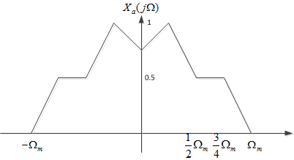
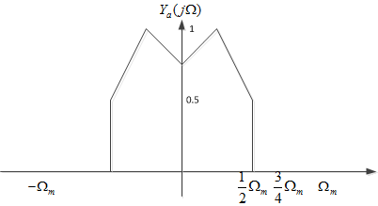
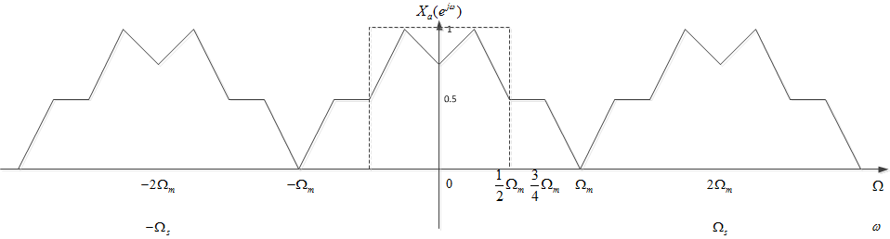
3.65 Solution

Slide 13
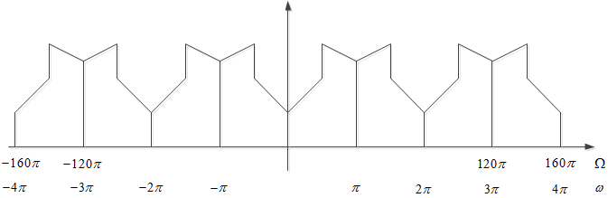
3.66 Solution

